Slide 1

General Biology
Dr. sraa nsayef

Slide 2
The cell
Lab ((4))

Slide 3
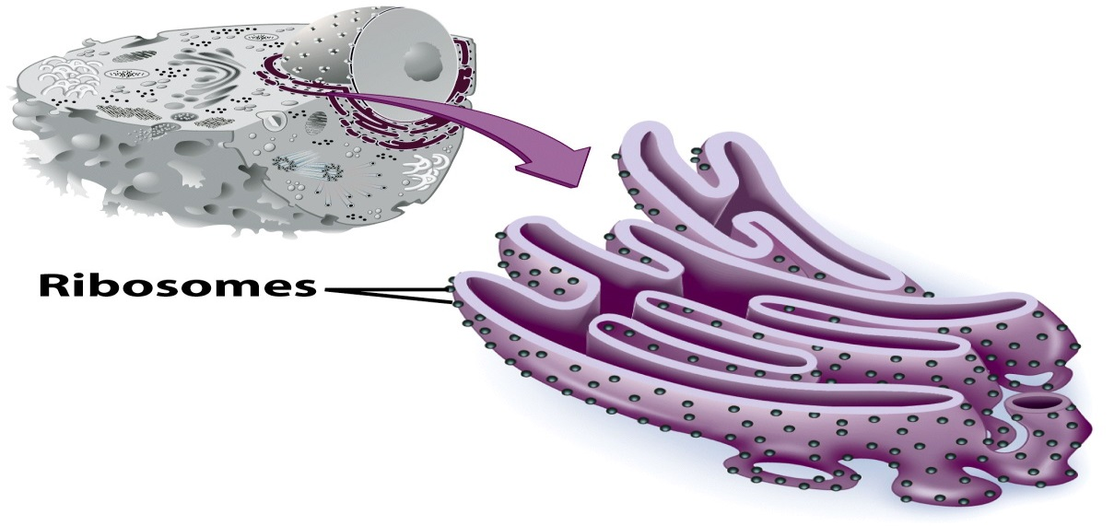
Endoplasmic Reticulum
1- Rough Endoplasmic Reticulum

Slide 4
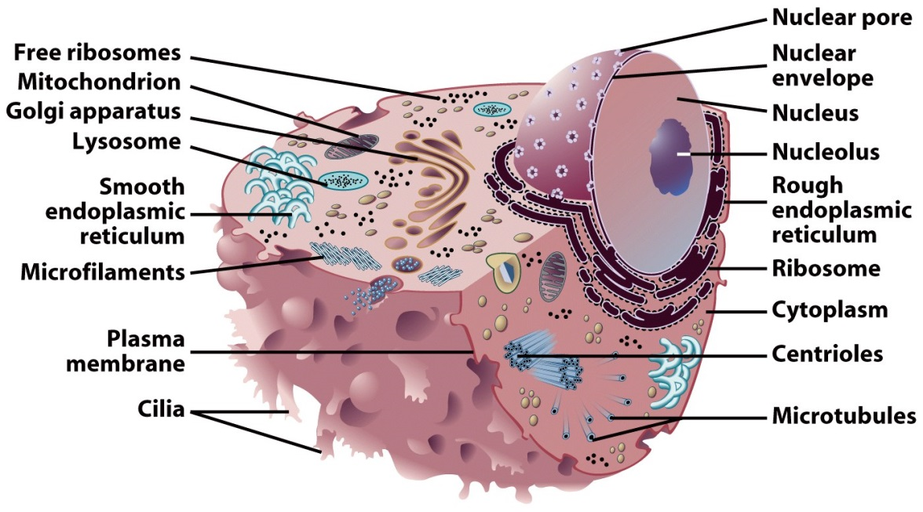
Smooth Endoplasmic Reticulum

Slide 5
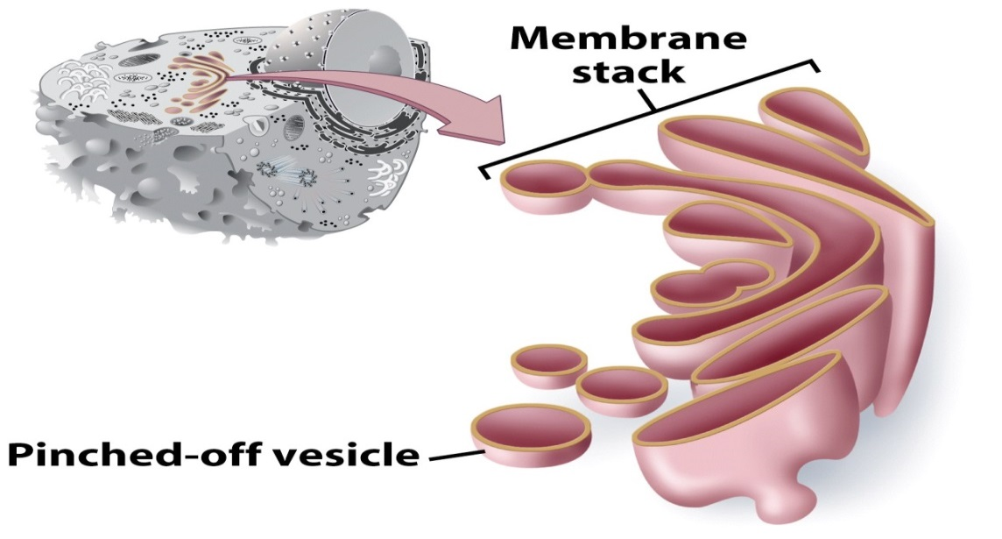
Golgi Apparatus

Slide 6
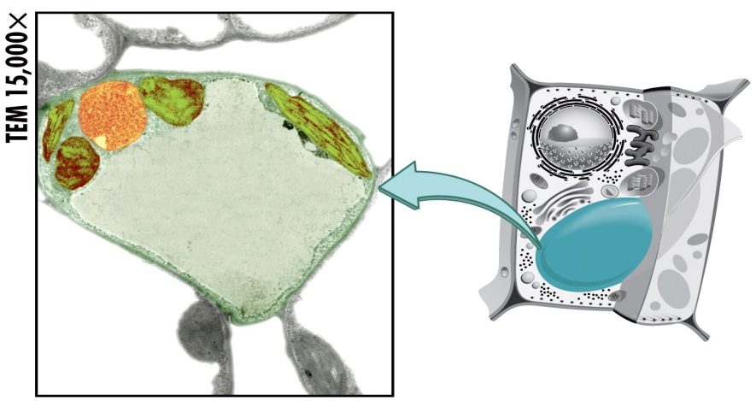
Vacuoles

Slide 7
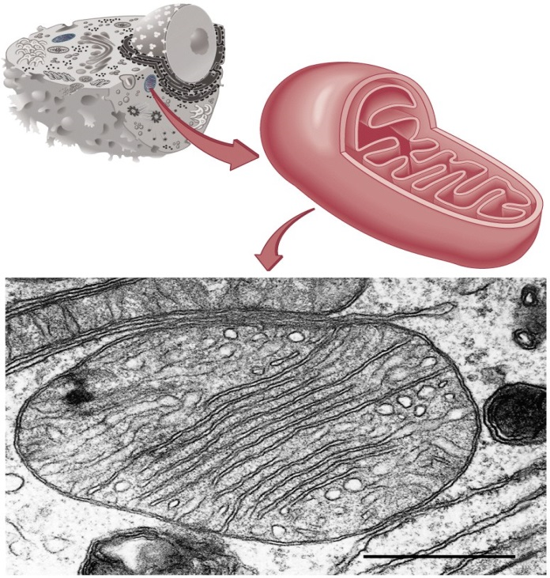
Mitochondria

Slide 8
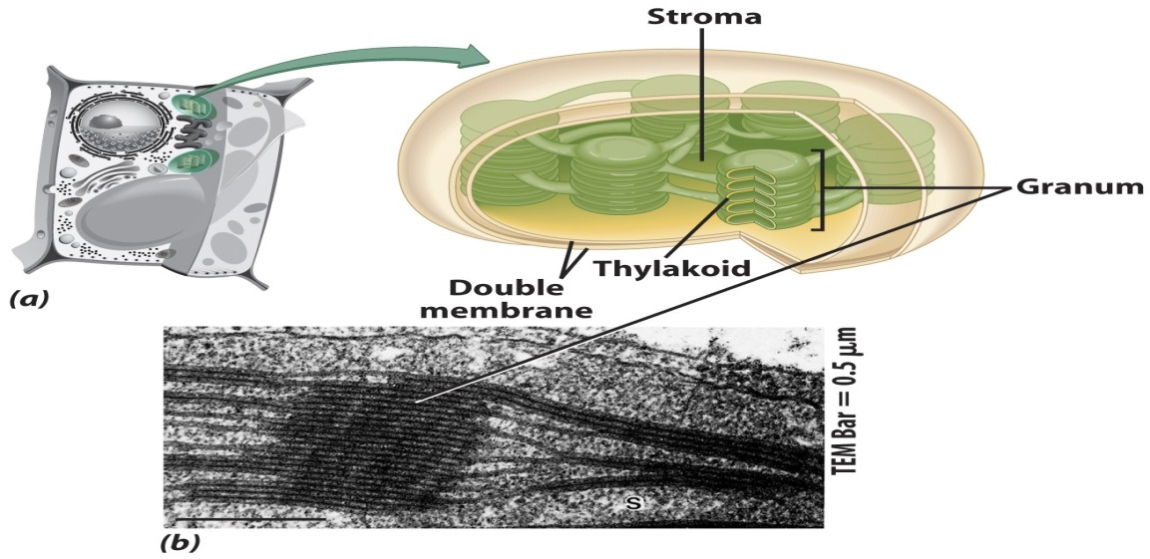
Chloroplasts

